Slide 2
Value-based smart reminders
Finding appropriate moments for
notifications in smart reminder systems
Notes:
Thank you all for being here
Rather than ending with it, I would first like to thank supervision Birna van Riemsdijk, Willem paul brinkman & Myrthe Tielman
Road long, switched studies twice, worked for three years, dancing, many championships: nationals, european, worlds
After almost 10 years of studying, finally standing in front of you.
Grandma
Topic @ interactive intelligence
Remembering the little things, like closing and locking all doors before sleeping.

Slide 3
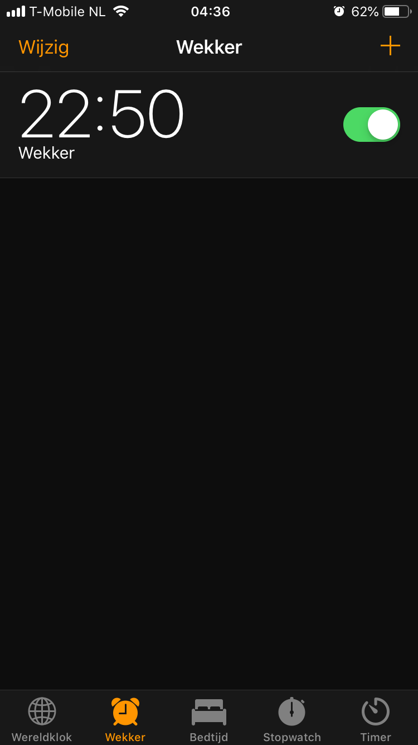
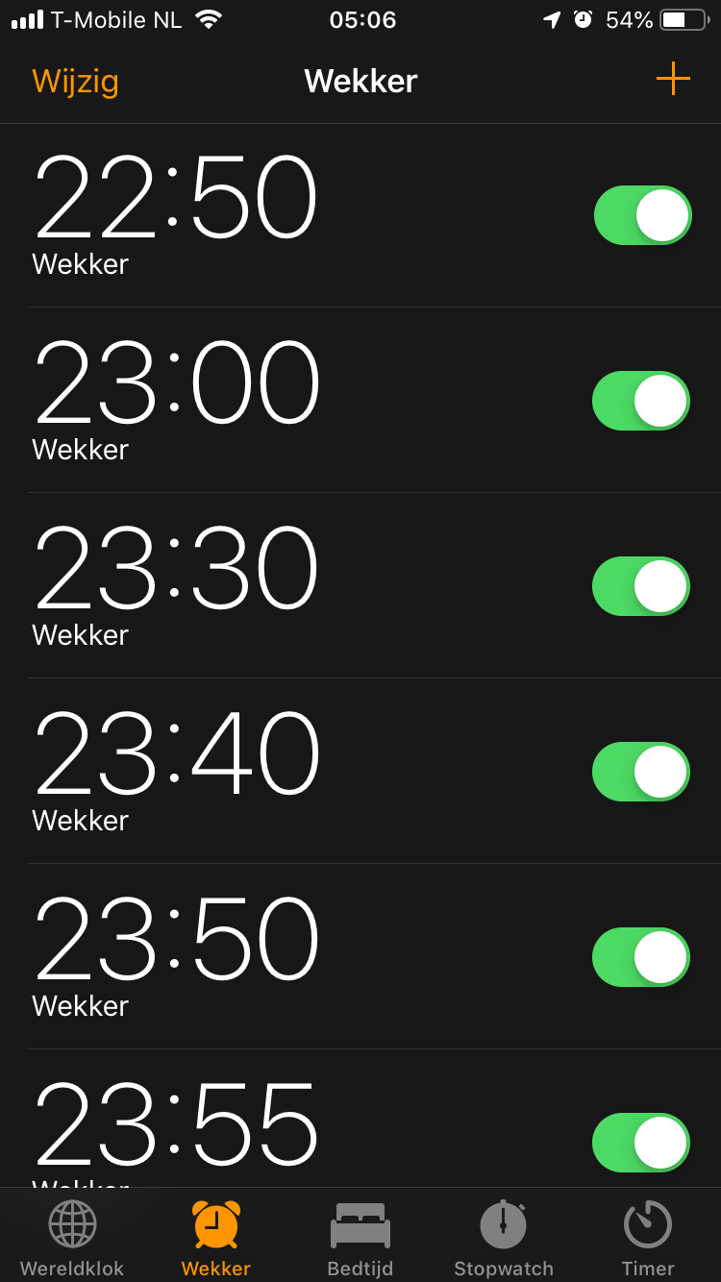
Value-based smart reminders
Finding appropriate moments for
notifications in smart reminder systems
Notes:
Simple solution alarm, which would maybe work
My case
----NEXT----
Ultimately leads to

Slide 5
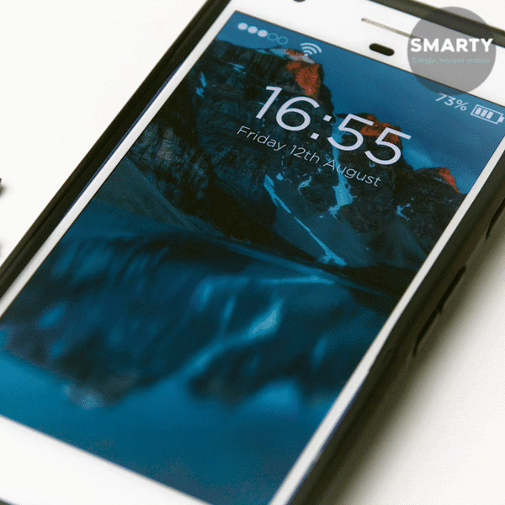
Notes:
Phone looking like this.
People who know me -> this is like my phone -> don’t respond quickly
Rather than being overloaded.
You want that right notification at the right time.
So basically like a mom.

Slide 6
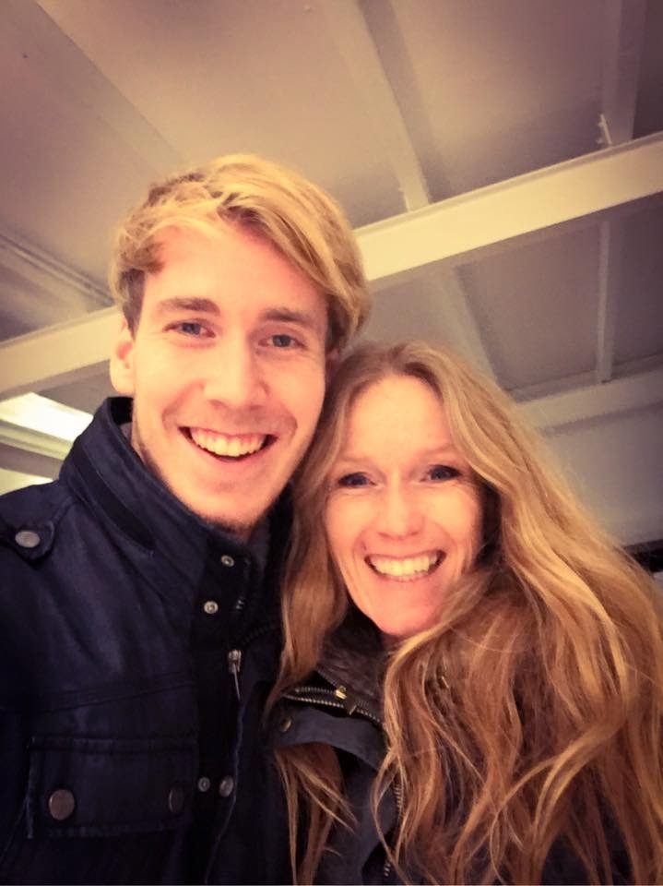

Notes:
”Sweetie, don’t forget to…”
(sorry mam)
Always right reminder at the right time. Why?

Slide 7
Values

Slide 8
Values

Slide 9
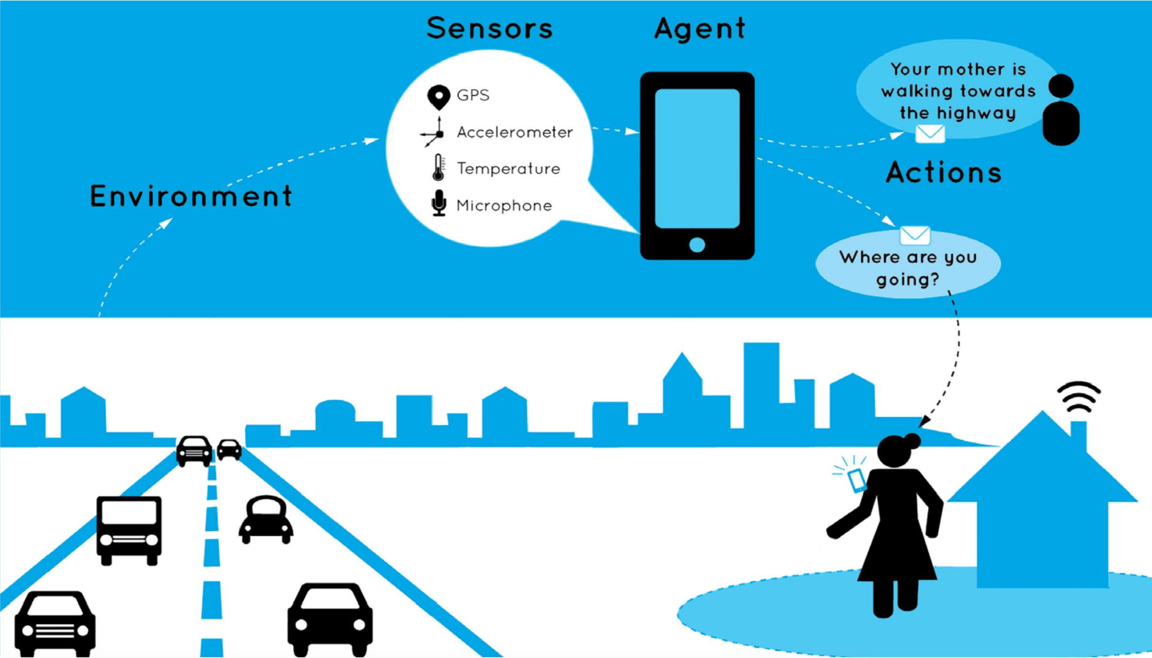

Slide 10

Notes:
Values from original supervisors
SAEP – socially adaptive electronic partner.
Used in support, eg. Alzheimer patients
Now: data user/environment
Rigid structure, not taking into account privacy, norms and values

Slide 11
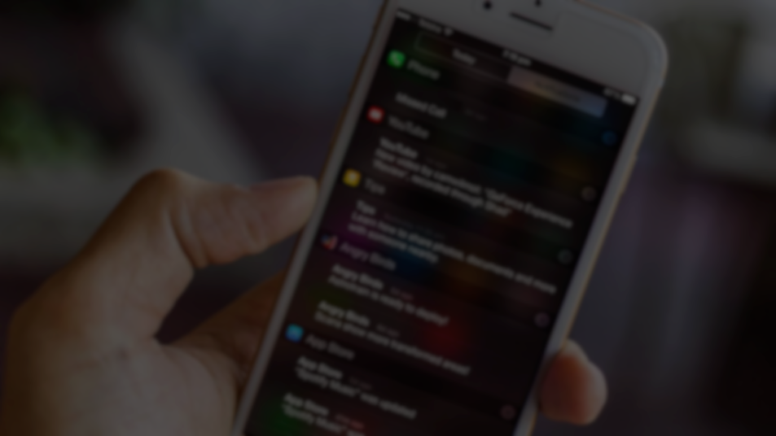
When to notify?

Slide 12
When to notify?
Notes:
Goal: to find a moment when to notify
Specifically, through the use of values.

Slide 13
When to notify?
How can a smart reminder system be extended to incorporate user
values to provide more appropriately timed notifications?
Notes:
Take existing prediction concept and extend it with values
Most appropriate = most value increase

Slide 15
Notes:
Take existing prediction concept and extend it with values

Slide 16

What don’t we want?
What do we need?
Design time
Specific setup
Non-reproducible

Slide 17
What don’t we want?
What do we need?
Design time
User’s past activities
Specific setup
Predict future activities
Non-reproducible
Connect values to activities
Combine all to
select moment
Notes:
No focus on activity recognition
For now data set, or app like olisto

Slide 18
What don’t we want?
What do we need?
Design time
User’s past activities
Specific setup
Predict future activities
Non-reproducible
Connect values to activities
Combine all to
select moment
NotiVal
Introducing

Slide 19
NotiVal
Introducing

Slide 20
Watching TV – Promotes Happiness
Do work – Promotes Career
07:45
8:15
08:00
09:00
Brushing teeth – Promotes Health
Eating – Promotes Health
Notes:
Assumptions: Explain that we have this in dataset or will still collect through an app
Activities directly promoting/demoting values
Notification might not ruin value, requires separate data.
Find least annoying.
Time → why is later notification importante → later = better remembering = more value from reminder

Slide 21
Watching TV – Very Annoying
Do work – Unacceptable
07:45
8:15
08:00
09:00
Brushing teeth – Slightly Annoying
Eating – Slightly Annoying
Notes:
Assumptions: Explain that we have this in dataset or will still collect through an app
Activities directly promoting/demoting values
Notification might not ruin value, requires separate data.
Find least annoying.
Fins latest

Slide 22
?

Slide 23
Activity prediction
?

Slide 24
Activity prediction
Notes:
Many options
Clustering and data mining to find temporal relations

Slide 25
Activity prediction
Data mining
Clustering
Notes:
Brief explanation

Slide 26
Activity prediction
Data mining
Apriori algorithm
… ‣ Sleep ‣ Toilet ‣ Eat ‣ TV ‣ …
… ‣ Toilet ‣ Shower ‣ Eat ‣ Toilet ‣ …
Clustering
… ‣ Work ‣ Toilet ‣ Shower ‣ Eat ‣ …
… ‣ Sleep ‣ Toilet ‣ Shower ‣ Eat ‣ …
… ‣ Shower ‣ Toilet ‣ Eat ‣ Work ‣ …
… ‣ Work ‣ Toilet ‣ Work ‣ Toilet ‣ …
Notes:
Apriori – mainly used within transactions.
Which items bought together
Also works with sequences

Slide 27
Activity prediction
Data mining
Apriori algorithm
… ‣ Sleep ‣ Toilet ‣ Eat ‣ TV ‣ …
… ‣ Toilet ‣ Shower ‣ Eat ‣ Toilet ‣ …
Clustering
… ‣ Work ‣ Toilet ‣ Shower ‣ Eat ‣ …
… ‣ Sleep ‣ Toilet ‣ Shower ‣ Eat ‣ …
… ‣ Shower ‣ Toilet ‣ Eat ‣ Work ‣ …
… ‣ Work ‣ Toilet ‣ Work ‣ Toilet ‣ …
Notes:
Toilet – 8

Slide 28
Activity prediction
Data mining
Apriori algorithm
… ‣ Sleep ‣ Toilet ‣ Eat ‣ TV ‣ …
… ‣ Toilet ‣ Shower ‣ Eat ‣ Toilet ‣ …
Clustering
… ‣ Work ‣ Toilet ‣ Shower ‣ Eat ‣ …
… ‣ Sleep ‣ Toilet ‣ Shower ‣ Eat ‣ …
… ‣ Shower ‣ Toilet ‣ Eat ‣ Work ‣ …
… ‣ Work ‣ Toilet ‣ Work ‣ Toilet ‣ …
Notes:
Toilet – Eat – 2
Toilet – Shower – 3
Toilet – Work - 1

Slide 29
Activity prediction
Data mining
Apriori algorithm
… ‣ Sleep ‣ Toilet ‣ Eat ‣ TV ‣ …
… ‣ Toilet ‣ Shower ‣ Eat ‣ Toilet ‣ …
Clustering
… ‣ Work ‣ Toilet ‣ Shower ‣ Eat ‣ …
… ‣ Sleep ‣ Toilet ‣ Shower ‣ Eat ‣ …
… ‣ Shower ‣ Toilet ‣ Eat ‣ Work ‣ …
… ‣ Work ‣ Toilet ‣ Work ‣ Toilet ‣ …
Notes:
Toilet – Eat – now split
Toilet – Shower – all eat
You see patterns
Basic level of predictions

Slide 30
Activity prediction
Clustering
Expectation Maximization
Data mining
Apriori algorithm
Notes:
Grouping of data
Hair color – blond vs dark
Dark blonde
Rather than making distinction

Slide 31
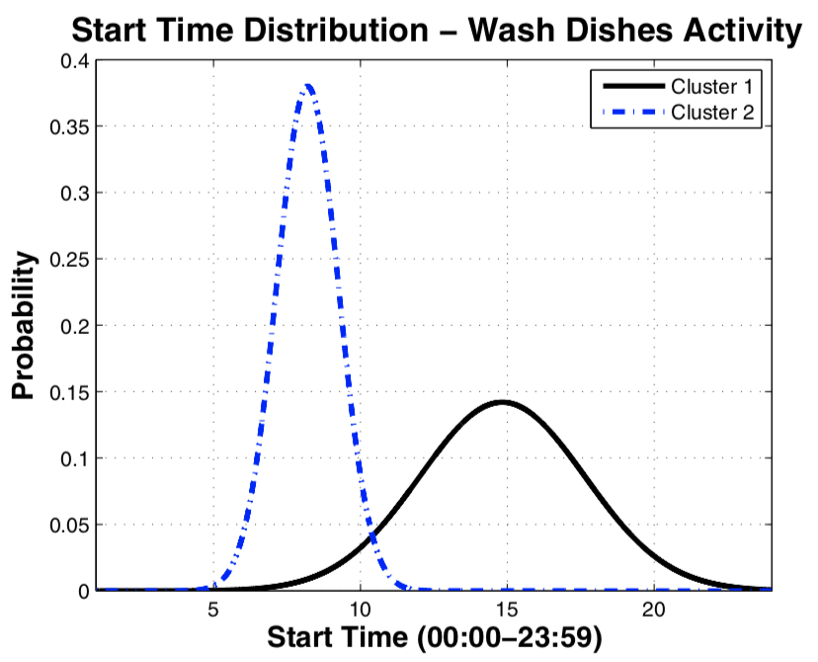
Activity prediction
Clustering
Expectation Maximization
Data mining
Apriori algorithm
Notes:
Variable used = starting time
Food morning → work
Food evening → not work (eg TV/bed)

Slide 32
Activity prediction
Data mining
Clustering
Apriori algorithm
Expectation Maximization
Notes:
So first cluster and the do data mining to get accurate prediction

Slide 33
Activity prediction
Data mining
Clustering
Apriori algorithm
Expectation Maximization
Notes:
So first cluster and the do data mining to get accurate prediction

Slide 34
Notes:
Recap

Slide 35
Data
Notes:
Recap

Slide 36
Data
Notes:
Recap

Slide 37
Data
Activity
Prediction
Notes:
Recap

Slide 38
Data
Activity
Prediction
Notes:
Recap

Slide 39
Data
Activity
Prediction
Value
Information
Notes:
Recap

Slide 40
Data
Activity
Prediction
Value
Information
Notes:
Recap

Slide 41
Data
Activity
Prediction
Suggested
Moment
Value
Information
Notes:
Recap

Slide 42
Data
Activity
Prediction
Value
Information
Suggested
Moment
Notes:
Recap

Slide 43
Notes:
As mentioned before in the timeline

Slide 44
Moment selection
Probability
Minimize time
Minimize annoyance
Notes:
Core of the paper, gonna get more technical
Do you all remember the timeline of activities a short while ago?
Minimize time: as late as possible, but before deadline

Slide 45
Moment selection
Probability
Minimize time
Minimize annoyance
Deadline:
The activity before which the notification should have been dispatched
Notes:
Core of the paper, gonna get more technical
Do you all remember the timeline of activities a short while ago?
Minimize time: as late as possible, but before deadline

Slide 46
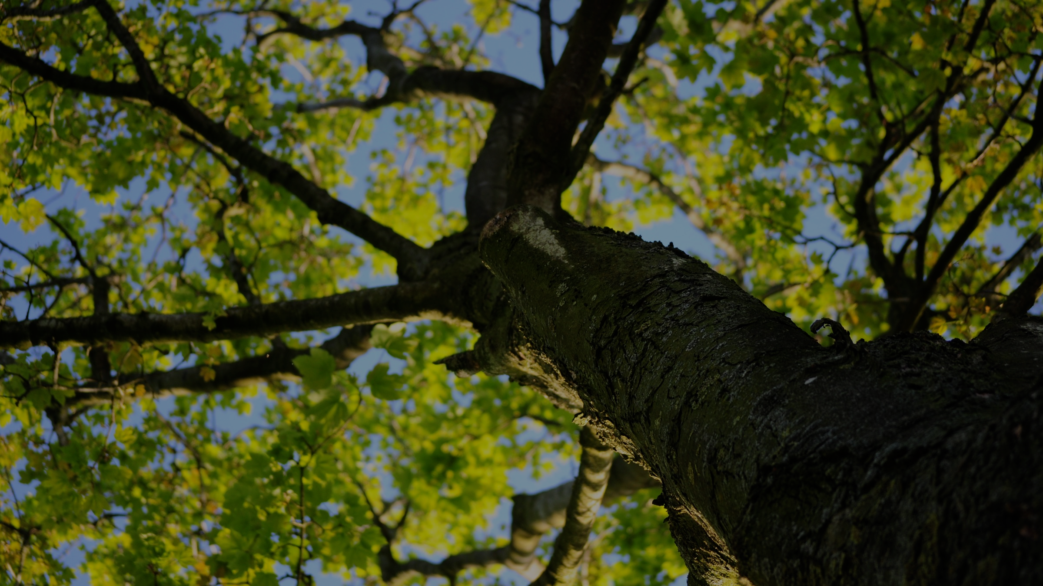
Notes:
Typical day modeled with these consecutive predictions

Slide 48
Markov chains

Slide 49

Markov chains
A
B
C
D
E

Slide 50
Markov chains
0.6
0.4
0.8
0.2
A [0]
B
[2]
C
[3]
D
[2]
1.0
0.3
0.7
0.2
1.0
E
[1]
0.5
0.3
Notes:
Cool thing about markov chains: many calculatable properties
Absorbing -> deadline

Slide 51
Markov chains
0.6
0.4
0.8
0.2
A [0]
B
[2]
C
[3]
D
[2]
1.0
1.0
0.3
0.2
1.0
Probability
E
[1]
0.5
Time
Value
Notes:
For every activity
Probability reaching activity
Time until the deadline

Slide 52
Moment selection
Probability
Minimize time
Minimize annoyance
Notes:
Which are the 3 needed. For the model.
Now how to select the moment

Slide 53
Notival
Don’t forget to close the doors before you go to sleep!
Moment selection
Probability
Minimize time
Minimize annoyance
Current activity
Calculate clusters
Next activity
Predict future activities
User values & Deadline
Compute model
Next
activity cluster
===
highest scoring cluster
Scoring function
Calculate score for each cluster
No?
Yes?
Notes:
Scoring function to maximize the probability, minimize the time and annoyance.

Slide 54
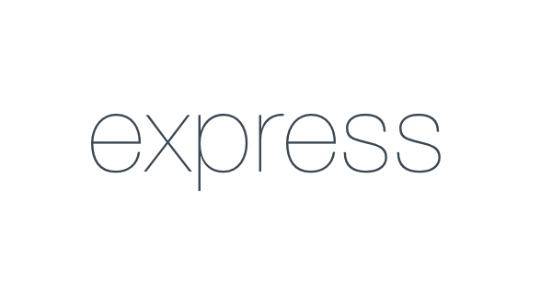
Notes:
Why do we have this? Any service or dataset

Slide 56
Value-based smart reminders
Finding appropriate moments for
notifications in smart reminder systems

